Slide 1

Validate Configured Subscription YANG-Push Publisher Implementations NETCONF & NMOP WG
IETF 121
November 2-3rd, 2024
Hackathon

Slide 2
Hackathon – Plan and Software
Test Plan
Validate work in progress vendor YANG-Push publisher implementations.
Configure RFC 8641 compliant YANG-Push configured subscription.
Verify output in packet capture before YANG-Push receiver and after transformation.
Development Plan
MVP 1 – Basic Requirements (9)
MVP 2 – Scale and Secure (3)
MVP 3 – Optimizations (2)
Software
YANG-Push Publisher - Cisco IOS XR
YANG-Push Publisher - 6WIND VSR
YANG-Push Publisher - Huawei VRP
YANG-Push Receiver – Pmacct
YANG-Push Receiver – Netgauze
udp-notif dissector - Wireshark

Slide 3
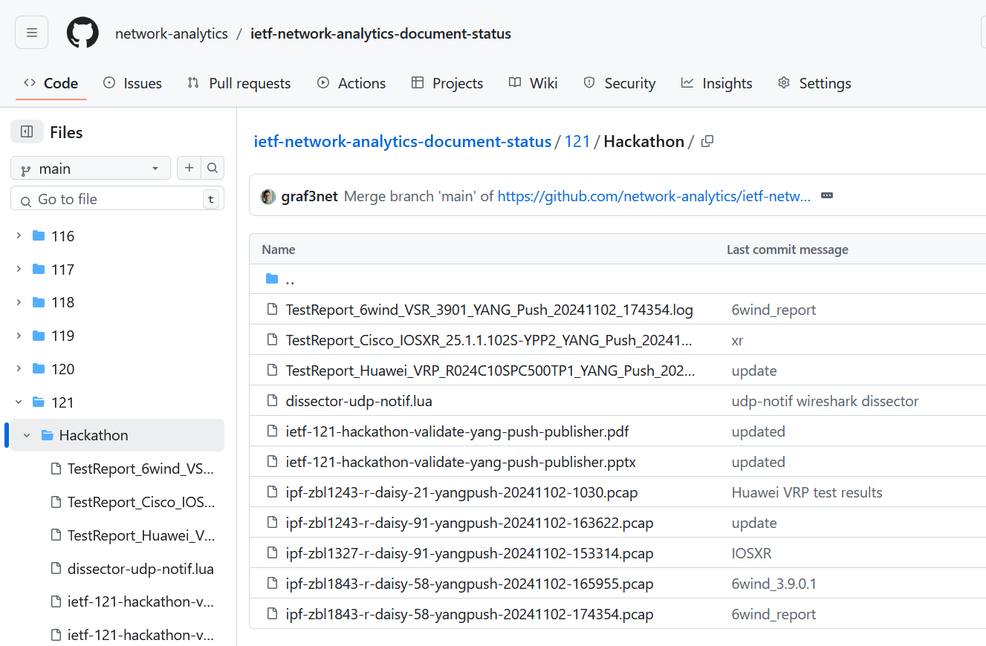
Hackathon – Repository
Test Repository
https://github.com/network-analytics/ietf-network-analytics-document-status/tree/main/121/Hackathon
Contains
Packet capture on the wire
Netconf RPCs and YANG-Push JSON messages
Python script which performed test cases

Slide 4
An Architecture for YANG-Push to Apache Kafka Integration draft-ietf-nmop-yang-kafka-integration
+------------------------------------------------------------+
| Time Series Database |
+------------------------------------------------------------+
^
| (12) Ingest Data
| According to Schema
+------------------------------------------------------------+
| Time Series Database Ingestion |
+------------------------------------------------------------+
(10) Get | ^ ^ (9) Validate
Schema | | | Serialized Message
| | | Schema on Consumer
| | |
| | +--------------------+
| | | Message |
| | | Broker |
| | +--------------------+
| | |
| | (11) Issue | (8) Serialize
| | | YANG-Push Message
| | | annotated Schema
v | Schema (6) Post | ID on Producer
+--------------------+ Schema +--------------------+
| YANG | <-------------- | Data Collection |
| Schema Registry | --------------> | YANG-Push Receiver |
+--------------------+ (7) Issue +--------------------+
Schema ID (4) Get | ^ (3) Receive
Schema | | YANG-Push
| | Subscription
| | Start Message
| | ^
| | |
| | | (5) Publish
| | | YANG-Push
| | | Message
| | | with
(1) Discover Notif. v | | Subscr. ID
+--------------------+ Capabilities +--------------------+
| Manage YANG-Push | ---------------> | Network Node |
| Subscription | (2) Subscribe | YANG-Push Publisher|
+--------------------+ ---------------> +--------------------+
Figure 1: End to End Workflow
Subscription to YANG Notifications RFC 8639
Subscription to YANG Notifications for Datastore Updates RFC 8641
UDP-based Transport for Configured Subscriptions draft-ietf-netconf-udp-notif
Subscription to Distributed Notifications draft-ietf-netconf-distributed-notif
Support of Hostname and Sequencing in YANG Notifications draft-tgraf-netconf-notif-sequencing
Support of Versioning in YANG Notifications Subscription draft-ietf-netconf-yang-notifications-versioning
Support of Network Observation Timestamping in YANG Notifications draft-tgraf-netconf-yang-push-observation-time
YANG Library RFC 8525
Augmented-by Addition into the IETF-YANG-Library draft-ietf-netconf-yang-library-augmentation

Slide 5

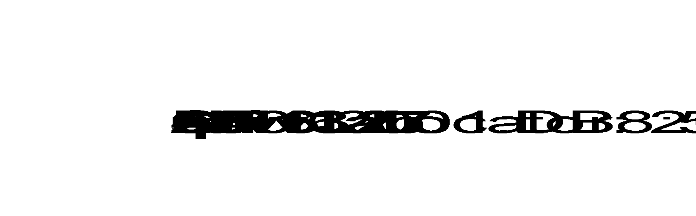

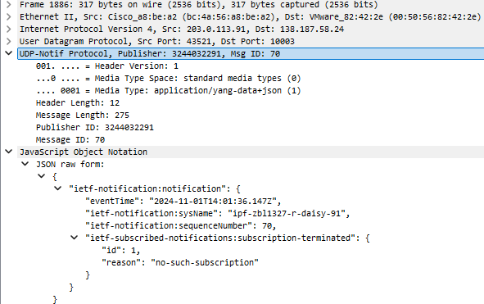
YANG-Push Data Processing Pipeline
Apache Kafka
{
"ietf-notification:notification": {
"eventTime": "2024-11-01T14:01:36.147Z",
"ietf-notification:sysName": "ipf-zbl1327-r-daisy-91",
"ietf-notification:sequenceNumber": 70,
"ietf-subscribed-notifications:subscription-terminated": {
"id": 1,
"reason": "no-such-subscription"
}
}
}
YANG-Push Publisher
YANG-Push Receiver
YANG Push JSON
Apache Kafka
JSON Message

Slide 6
Cisco IOS XR – Subscription Notifications
Subscription-Started Notification
{
"ietf-notification:notification": {
"eventTime": "2024-11-02T14:38:22.598Z",
"ietf-notification:sysName": "ipf-zbl1327-r-daisy-91",
"ietf-notification:sequenceNumber": 13,
"ietf-subscribed-notifications:subscription-started": {
"id": 1,
"ietf-yang-push:datastore": "IOS-XR",
"ietf-yang-push:datastore-xpath-filter": "Cisco-IOS-XR-pfi-im-cmd-oper:interfaces/interface-xr/interface[interface-name='Loopback13']",
"transport": "transport",
"module-version": [
{
"module-name": "Cisco-IOS-XR-pfi-im-cmd-oper",
"revision": "2024-02-29"
}
],
"encoding": "encode-json",
"ietf-yang-push:periodic": {
"period": 4500
}
}
}
}
Subscription-Terminated Notification
{
"ietf-notification:notification": {
"eventTime": "2024-11-02T14:43:24.981Z",
"ietf-notification:sysName": "ipf-zbl1327-r-daisy-91",
"ietf-notification:sequenceNumber": 21,
"ietf-subscribed-notifications:subscription-terminated": {
"id": 1,
"reason": "no-such-subscription"
}
}
}

Slide 7
Cisco IOS XR – Push Notifications
Push-Update Notification
{
"ietf-notification:notification": {
"eventTime": "2024-11-02T14:44:30.000Z",
"ietf-notification:sysName": "ipf-zbl1327-r-daisy-91",
"ietf-notification:sequenceNumber": 23,
"ietf-yang-push:push-update": {
"id": 1,
"ietf-yp-observation:timestamp": "2024-11-02T14:44:30.000Z",
"ietf-yp-observation:point-in-time": "current-accounting",
"datastore-contents": {
"Cisco-IOS-XR-pfi-im-cmd-oper:interfaces": {
"interface-xr": {
"interface": [
{
"interface-name": "Loopback13",
"interface-handle": "Loopback13",
"interface-type": "IFT_LOOPBACK",
"hardware-type-string": "Loopback interface(s)",
"state": "im-state-up",
"line-state": "im-state-up",
"encapsulation": "loopback",
"encapsulation-type-string": "Loopback",
"mtu": 1500,
Push-Change-Update Notification
{
"ietf-notification:notification": {
"eventTime": "2024-11-02T14:54:32.529Z",
"ietf-notification:sysName": "ipf-zbl1327-r-daisy-91",
"ietf-notification:sequenceNumber": 1,
"ietf-yang-push:push-change-update": {
"id": 1,
"ietf-yp-observation:timestamp": "2024-11-02T14:54:32.517Z",
"ietf-yp-observation:point-in-time": "state-changed",
"datastore-changes": {
"yang-patch": {
"patch-id": "TODO - insert patch-id here",
"edit": [
{
"edit-id": "1",
"operation": "replace",
"target": "/Cisco-IOS-XR-pfi-im-cmd-oper:interfaces/interface-xr/interface[interface-name='Loopback13']",
"value": {
"Cisco-IOS-XR-pfi-im-cmd-oper:interface": {
"interface-name": "Loopback13",
"interface-handle": "Loopback13",
"interface-type": "IFT_LOOPBACK",
"hardware-type-string": "Loopback interface(s)",
"state": "im-state-admin-down",
"line-state": "im-state-admin-down",

Slide 8
Huawei VRP – Push Notifications
Push-Update Notification
{
"ietf-notification:notification": {
"eventTime": "2024-11-02T10:30:52Z",
"ietf-notification-sequencing:sysName": "ipf-zbl1243-r-daisy-21",
"ietf-notification-sequencing:sequenceNumber": 5,
"ietf-yang-push:push-update": {
"id": 1,
"ietf-yp-observation:timestamp": "2024-11-02T10:30:52Z",
"ietf-yp-observation:point-in-time": "current-accounting",
"ietf-distributed-notif:message-publisher-id": 16974853,
"datastore-contents": {
"huawei-ifm:ifm": {
"interfaces": {
"interface": [
{
"name": "GigabitEthernet0/3/11",
"mib-statistics": {
"receive-byte": "33448478274",
"send-byte": "20330971890",
"receive-packet": "75363920",
"send-packet": "103904697",
"receive-unicast-packet": "75340369",
"receive-multicast-packet": "23548",
"receive-broad-packet": "3",
"send-unicast-packet": "103904697",
"send-multicast-packet": "0",
"send-broad-packet": "0",
Push-Change-Update Notification
{
"ietf-notification:notification": {
"eventTime": "2024-11-02T10:38:52Z",
"ietf-notification-sequencing:sysName": "ipf-zbl1243-r-daisy-21",
"ietf-notification-sequencing:sequenceNumber": 69,
"ietf-yang-push:push-change-update": {
"id": 5,
"ietf-yp-observation:timestamp": "2024-11-02T10:38:52Z",
"ietf-yp-observation:point-in-time": "state-changed",
"ietf-distributed-notif:message-publisher-id": 16974841,
"datastore-changes": {
"yang-patch": {
"patch-id": 19,
"edit": [
{
"edit-id": "edit1",
"operation": "merge",
"target": "/huawei-ifm:ifm/interfaces/interface[name=GigabitEthernet0/3/9]/dynamic",
"value": {
"dynamic": {
"link-status": "down"
}
}
},

Slide 9
Huawei VRP – YANG Library
RPC <get> Request
<?xml version="1.0" encoding="UTF-8"?>
<rpc xmlns="urn:ietf:params:xml:ns:netconf:base:1.0" message-id="2">
<get>
<filter type="subtree">
<yang-library xmlns="urn:ietf:params:xml:ns:yang:ietf-yang-library" />
</filter>
</get>
</rpc>
RPC reply
<?xml version="1.0" encoding="UTF-8"?>
<rpc-reply message-id="2" xmlns="urn:ietf:params:xml:ns:netconf:base:1.0">
<data>
<yang-library xmlns="urn:ietf:params:xml:ns:yang:ietf-yang-library">
<content-id>3880047851</content-id>
<module-set>
<name>config-module</name>
<module>
<name>openconfig-acl</name>
<revision>2017-05-26</revision>
<namespace>http://openconfig.net/yang/acl</namespace>
<deviation>huawei-openconfig-acl-deviations-OC-NE-M2K-B</deviation>
</module>
<module>
<name>openconfig-interfaces</name>
<revision>2021-04-06</revision>
<namespace>http://openconfig.net/yang/interfaces</namespace>
<deviation>huawei-openconfig-interfaces-deviations-OC-NE-M2K-B</deviation>
<augmented-by>huawei-openconfig-qos-ext</augmented-by>
<augmented-by>openconfig-vlan</augmented-by>
<augmented-by>openconfig-platform-transceiver</augmented-by>
<augmented-by>openconfig-platform-port</augmented-by>
<augmented-by>openconfig-if-tunnel</augmented-by>
<augmented-by>openconfig-if-ip</augmented-by>
<augmented-by>openconfig-if-ethernet</augmented-by>
<augmented-by>openconfig-if-aggregate</augmented-by>
</module>

Slide 10
6WIND VSR – Subscription Notifications
Subscription-Started Notification
{
"ietf-notifications:notification": {
"eventTime": "2024-11-02T16:20:16.989632098+00:00",
"ietf-notification-sequencing:sysName": "daisy-ietf-ipf-zbl1843-r-daisy-58",
"ietf-notification-sequencing:sequenceNumber": 11008,
"ietf-subscribed-notifications:subscription-started": {
"id": 12345678,
"ietf-yang-push:datastore": "ietf-datastores:operational",
"ietf-yang-push:datastore-xpath-filter": "/state/vrf/l3vrf/interface/loopback/enabled",
"transport": "ietf-udp-notif-transport:udp-notif",
"encoding": "encode-json",
"purpose": "send notifications",
"ietf-distributed-notif:message-publisher-ids": [
0
],
"ietf-yang-push:on-change": {
"sync-on-start": true
},
"ietf-yang-push-revision:module-version": [
{
"module-name": "vrouter-loopback",
"revision": "2024-04-22"
}
]
}
}
}
Subscription-Terminated Notification
{
"ietf-notifications:notification": {
"eventTime": "2024-11-02T16:25:19.639303753+00:00",
"ietf-notification-sequencing:sysName": "daisy-ietf-ipf-zbl1843-r-daisy-58",
"ietf-notification-sequencing:sequenceNumber": 11014,
"ietf-subscribed-notifications:subscription-terminated": {
"id": 12345678,
"reason": "no-such-subscription"
}
}
}}

Slide 11
6WIND VSR – Push Notifications
Push-Update Notification
{
"ietf-notifications:notification": {
"eventTime": "2024-11-02T16:25:20.795276882+00:00",
"ietf-notification-sequencing:sysName": "daisy-ietf-ipf-zbl1843-r-daisy-58",
"ietf-notification-sequencing:sequenceNumber": 11016,
"ietf-yang-push:push-update": {
"id": 9,
"datastore-contents": {
"vrouter:state": {
"vrf": [
{
"name": "main",
"vrouter-interface:interface": {
"physical": [
{
"name": "ens192",
"counters": {
"in-octets": "68993004950",
"in-unicast-pkts": "389889038",
"in-discards": "69240",
"in-errors": "0",
"out-octets": "65180577234",
"out-unicast-pkts": "330829342",
"out-discards": "0",
"out-errors": "0"
}
}
Push-Change-Update Notification
{
"ietf-notifications:notification": {
"eventTime": "2024-11-02T16:21:17.889933885+00:00",
"ietf-notification-sequencing:sysName": "daisy-ietf-ipf-zbl1843-r-daisy-58",
"ietf-notification-sequencing:sequenceNumber": 11010,
"ietf-yang-push:push-change-update": {
"id": 8,
"datastore-changes": {
"yang-patch": {
"patch-id": "patch-1",
"edit": [
{
"edit-id": "edit-1",
"operation": "replace",
"target": "/vrouter:state/vrf[name='main']/l3vrf[name='A9']/vrouter-interface:interface/vrouter-loopback:loopback[name='Loopback-A9']/enabled",
"value": {
"vrouter-loopback:enabled": "false"
}
}
]
}
}

Slide 12
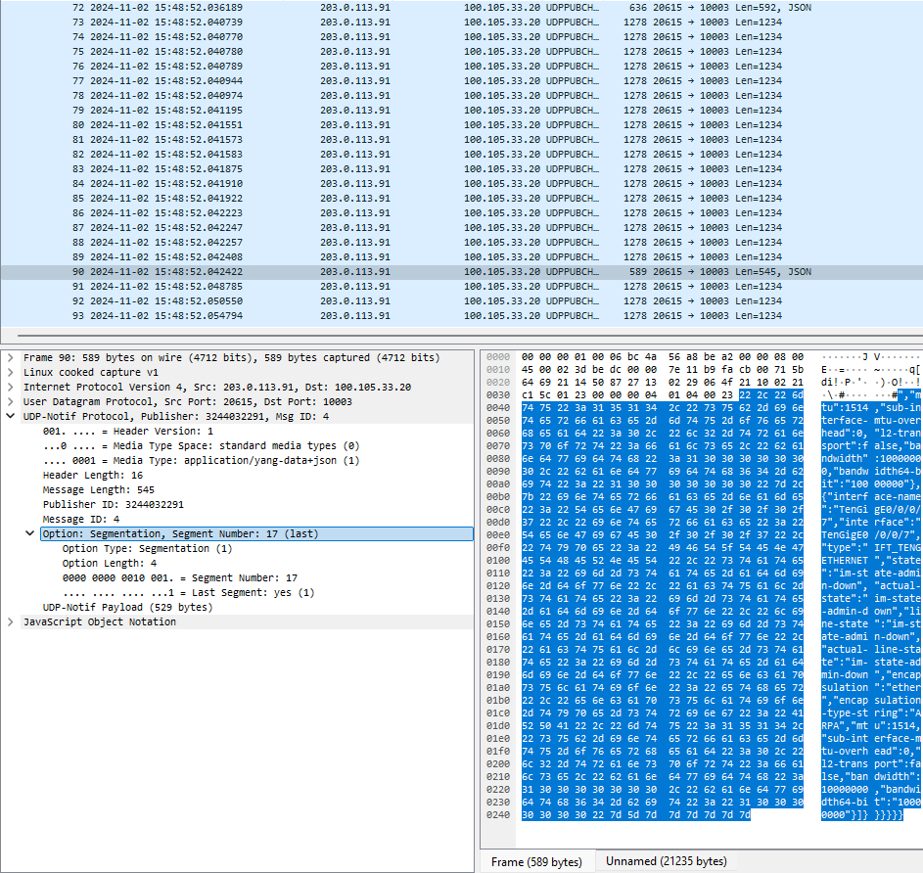
Udp-notif - Segmentation
YANG-Push Publisher
Huawei VRP
6WIND VSR
Cisco IOS XR
YANG-Push Receiver
Pmacct https://github.com/pmacct/pmacct
Netgauze https://github.com/NetGauze/NetGauze
Tools
Wireshark dissector https://github.com/network-analytics/ietf-network-analytics-document-status/tree/main/121/Hackathon

Slide 13

YANG-Push Implementation Status IETF 121 – MVP 1
 | 6WIND VSR | Huawei VRP | Cisco IOS XR | Open-Source
RFC 8639 YANG-Push Subscription | ✔ | P | P
RFC 8641 YANG-Push Notification | ✔ | P | ✔
draft-ietf-netconf-udp-notif | ✔ | ✔ | ✔ | ✔
draft-ietf-netconf-yang-notifications-versioning | ✔ | ✔ | ✔
draft-tgraf-netconf-notif-sequencing | ✔ | ✔ | ✔
draft-tgraf-netconf-yang-push-observation-time | ✔ | ✔ | ✔
RFC 7895 YANG Library |  | ✔
RFC 8525 YANG Library (NMDA) | ✔ |  | ✔
draft-ietf-netconf-yang-library-augmentation |  | P |  | ✔
RFC 9196 System and Notification Capabilities
draft-netana-netconf-notif-envelope
Green marked describes new capability at IETF 121. "P" to partially implemented.

Slide 14
YANG-Push Implementation Status IETF 121 – MVP 2
 | 6WIND VSR | Huawei VRP | Cisco IOS XR | Open-Source
draft-ietf-netconf-distributed-notif | ✔ | ✔
RFC 9254 CBOR
RFC 6347/RFC 9147 DTLS
Green marked describes new capability at IETF 121. "P" to partially implemented

Slide 15
YANG-Push Implementation Status IETF 121 – MVP 3
 | 6WIND VSR | Huawei VRP | Cisco IOS XR | Open-Source
RFC 8641 on-change subscriptions | ✔ | ✔ | P
draft-netana-netconf-yp-transport-capabilities
Green marked describes new capability at IETF 121. "P" to partially implemented

Slide 16
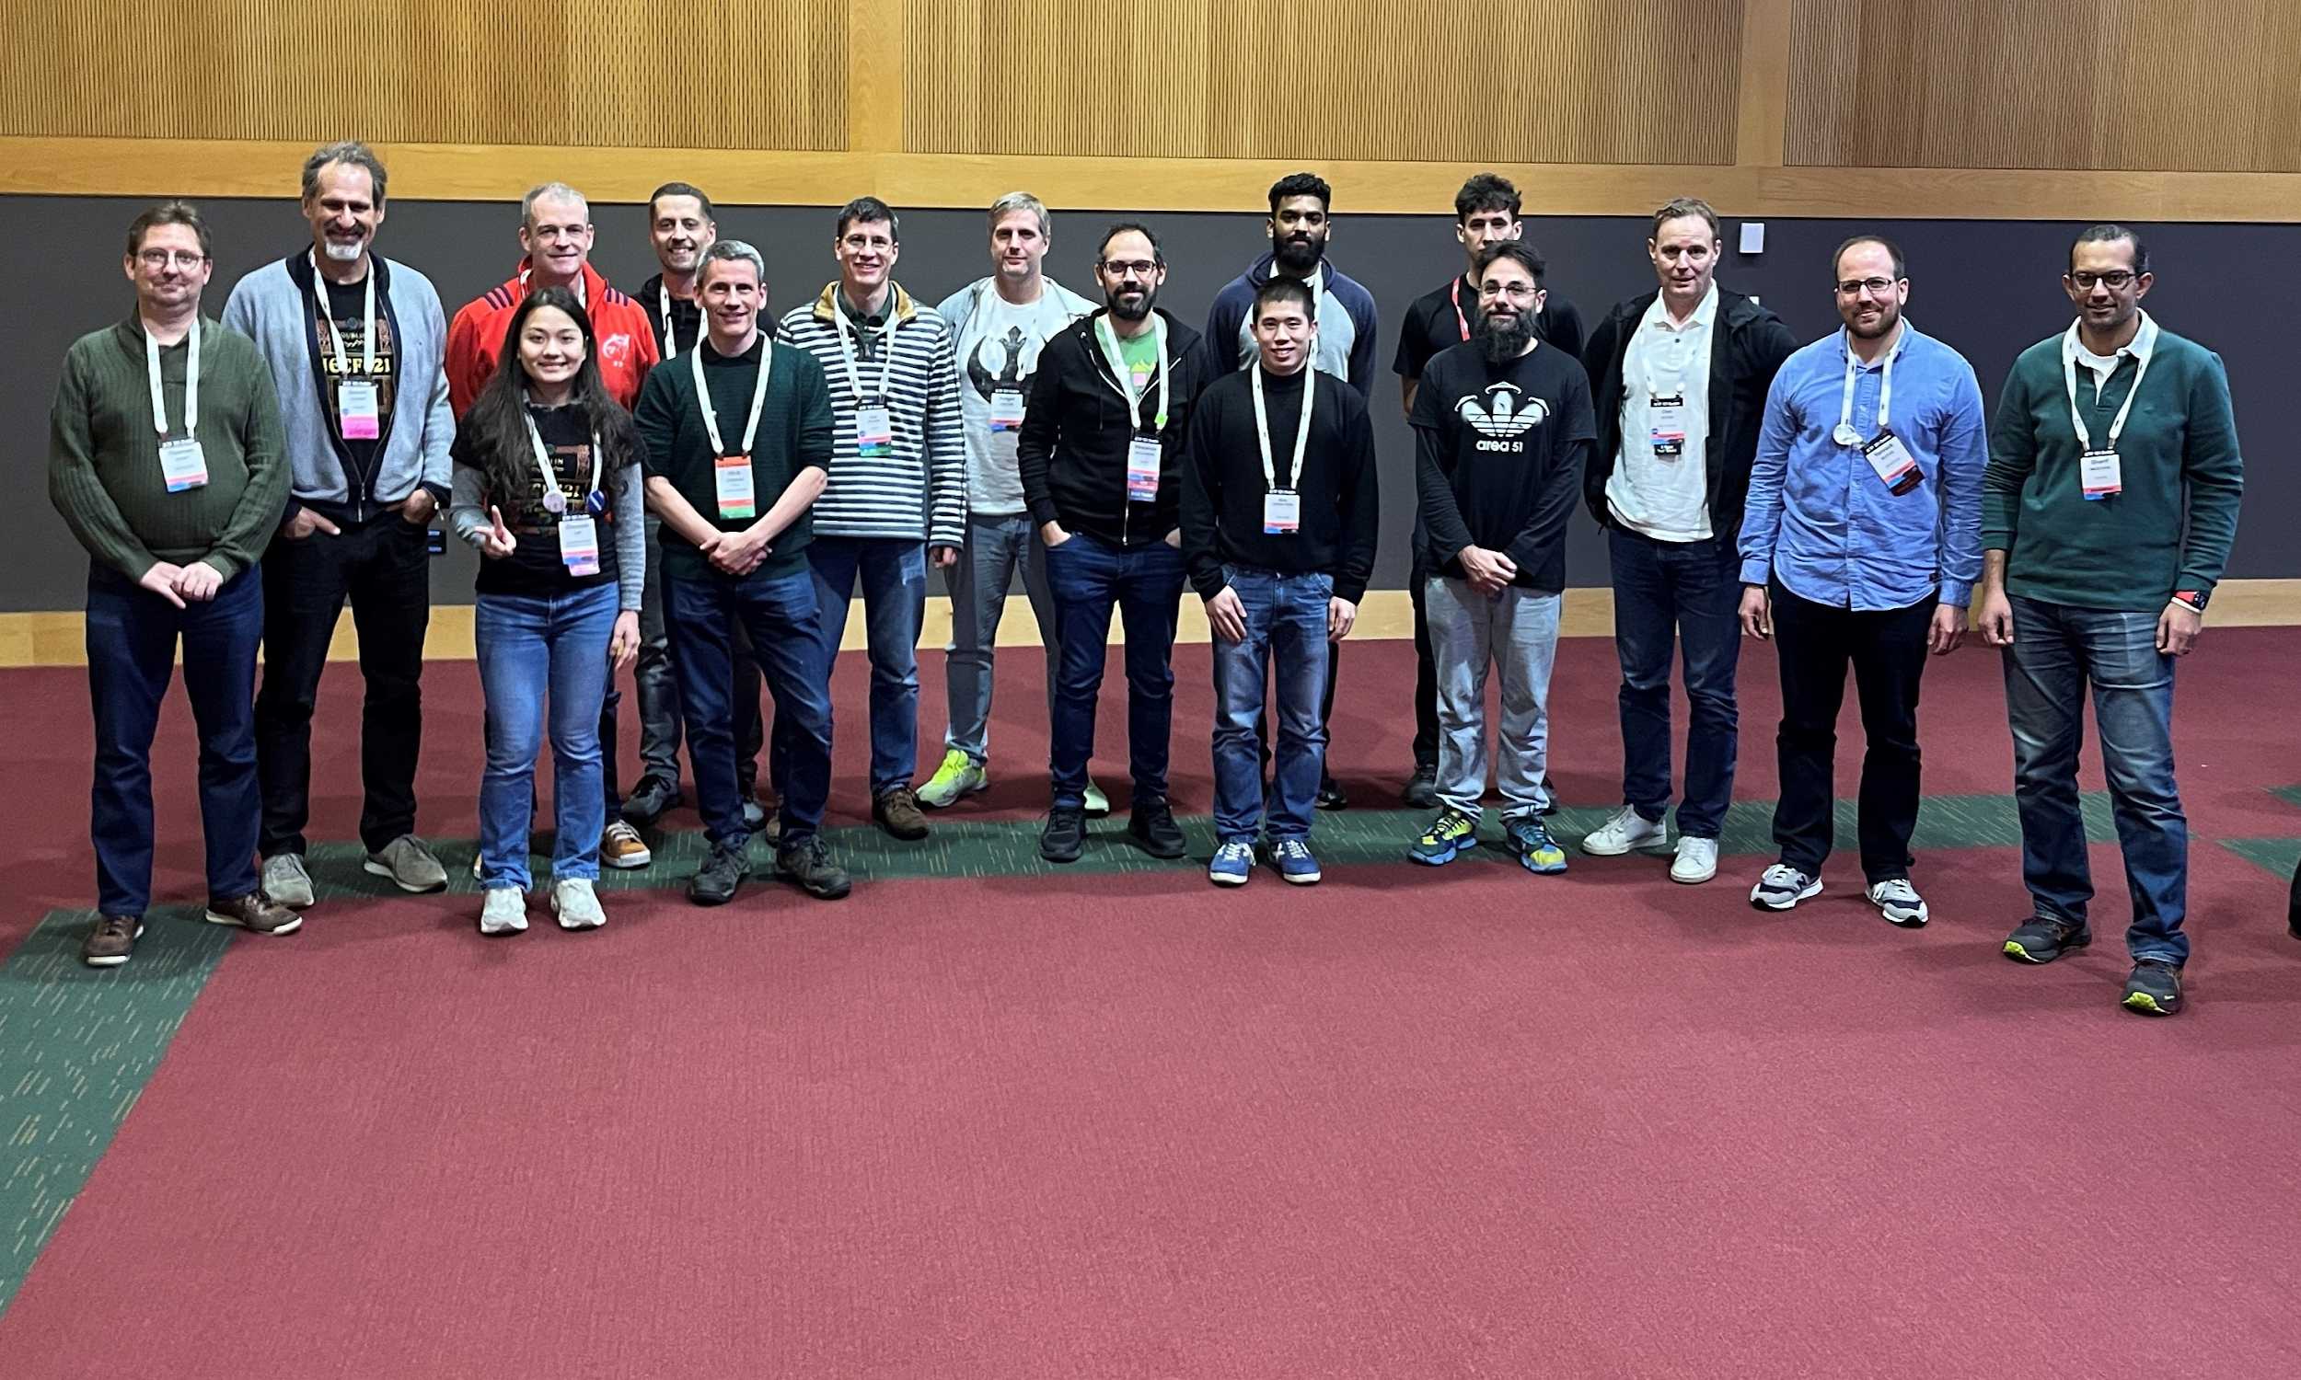
Thanks to…
Rob Wilton – Cisco
Nick Corran - Cisco
Emma Rankin – Cisco (remote)
Mathew Green – Cisco (remote)
Samuel Gauthier – 6WIND (remote)
Jérémie Leska – 6WIND (remote)
Liu Bin – Huawei (remote)
Benoit Claise – Huawei
Zhuoyao Lin - Huawei
Ebben Aries – Juniper
James Cummings - Nokia
Paolo Lucente – Pmacct
Holger Keller – DT
Daniel Voyer – Bell Canada
Alex Huang-Feng – INSA Lyon
Yannick Buchs – Swisscom
Thomas Graf – Swisscom
Ahmed Elhassany – Swisscom (remote)
Uwe Storbeck – Swisscom (remote)

